Slide 1

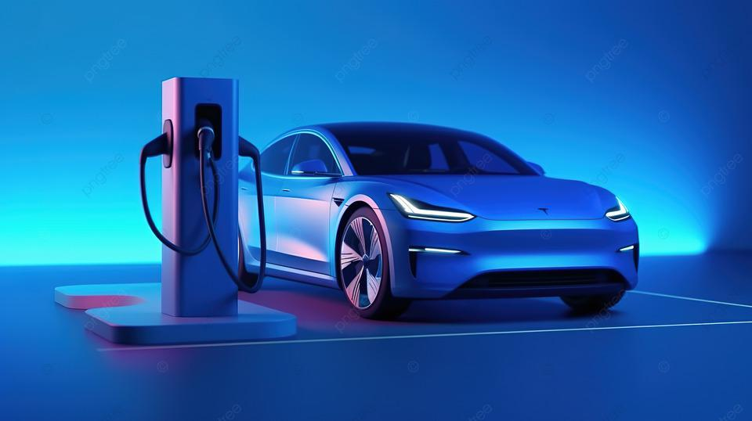
Electric Vehicle Market Analysis in India
AtliQ Motors

Slide 2
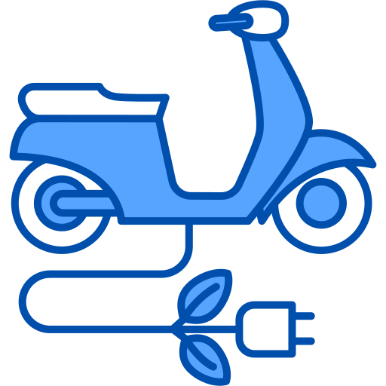

AtliQ Motors
AtliQ Motors, a major automotive company from the USA specializing in electric vehicles (EVs), has seen its market share in the electric and hybrid vehicle segment in North America rise to 25% over the past five years. As part of their expansion strategy, the company aims to introduce their top-selling models in India, where their current market share is under 2%.
To move forward, I aim to provide actionable insights and recommendations to help AtliQ motors penetrate the Indian EV market successfully. This involves identifying key metrics, growth opportunities, and strategic initiatives to expand market shares effectively.

Slide 3
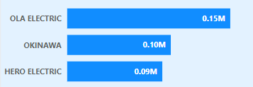
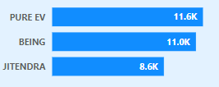
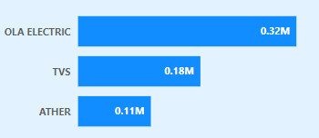
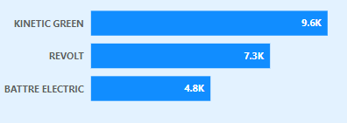
1. List the top 3 and bottom 3 makers for the fiscal years 2023 and 2024 in terms of the number of 2-wheelers sold.
Top 3 Makers in 2023:
Bottom 3 Makers in 2023:
Top 3 Makers in 2024:
Bottom 3 Makers in 2024:

Slide 4
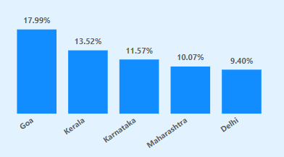
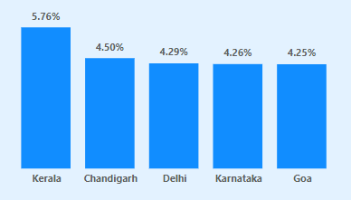
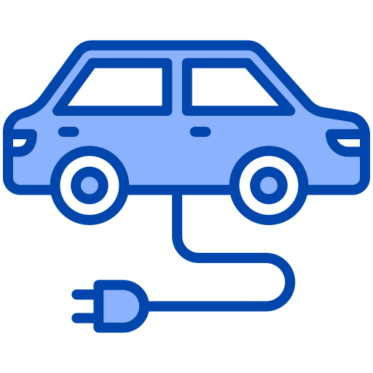
2. Identify the top 5 states with the highest penetration rate in 2-wheeler and 4-wheeler EV sales in FY 2024.
Top 5 states with highest penetration rate in 2-Wheeler catgory in 2024:
Top 5 states with highest penetration rate in 4-Wheeler catgory in 2024:

Slide 5
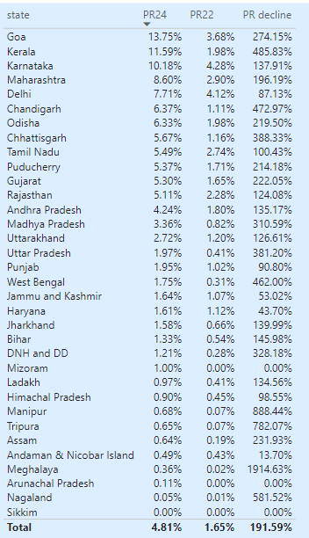
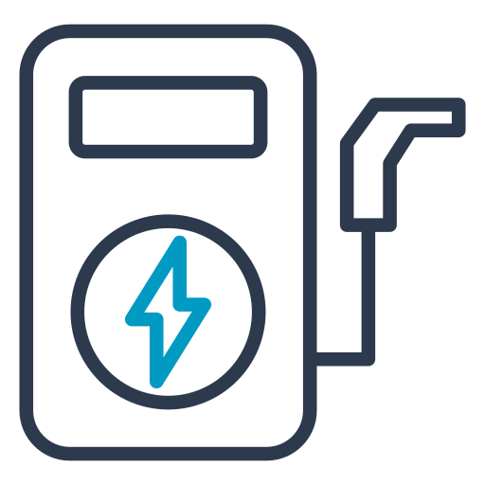
3. List the states with negative penetration (decline) in EV sales from 2022 to 2024?

Slide 6
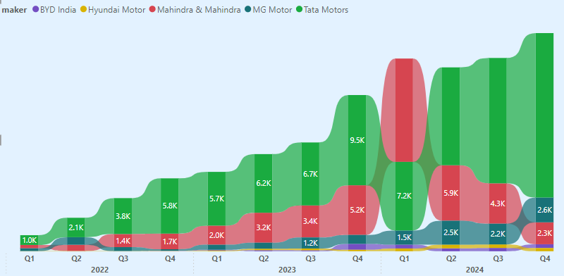
4. What are the quarterly trends based on sales volume for the top 5 EV makers (4-wheelers) from 2022 to 2024?
Top 5 Makers quarterly trends in 2024 for 4-Wheelers category:

Slide 7
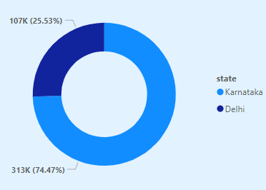
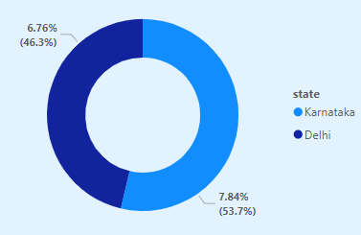
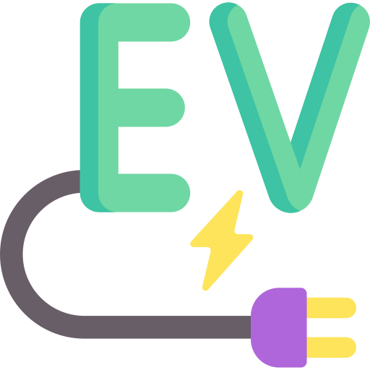
5. How do the EV sales and penetration rates in Delhi compare to Karnataka for 2024?
Total Evs sold in Delhi Vs Karnataka I 2024
Total penetration in Delhi Vs Karnataka in 2024:

Slide 8

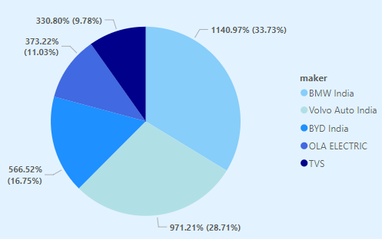
6. List down the compounded annual growth rate (CAGR) in 4-wheeler units for the top 5 makers from 2022 to 2024.

Slide 9

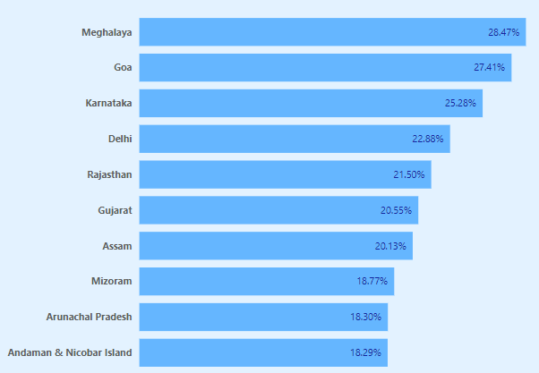
7. List down the top 10 states that had the highest compounded annual growth rate (CAGR) from 2022 to 2024 in total vehicles sold.
Top 10 states with highest compounded annual growth rat(CAGR) for Total Vehicles sold::

Slide 10
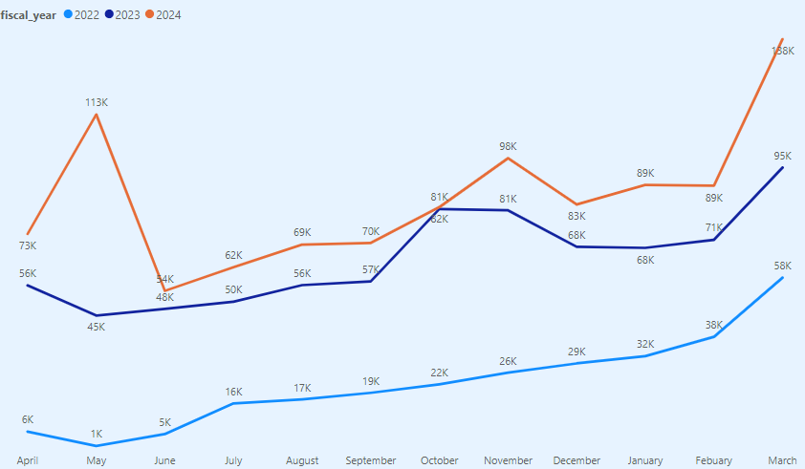
8. What are the peak and low season months for EV sales based on the data from 2022 to 2024?

Slide 11
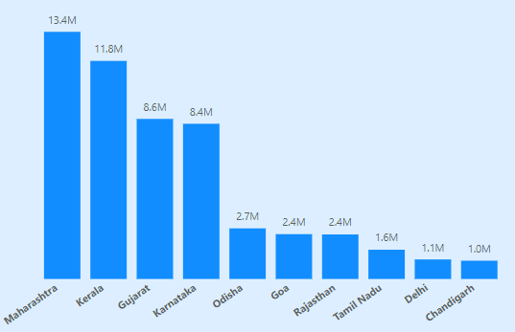
9. What is the projected number of EV sales (including 2-wheelers and 4- wheelers) for the top 10 states by penetration rate in 2030, based on the compounded annual growth rate (CAGR) from previous years?
Projected number of EV sales for TOP 10 stats by penetration rate:

Slide 12
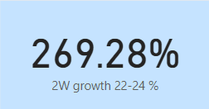
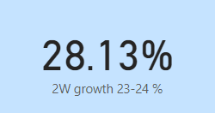
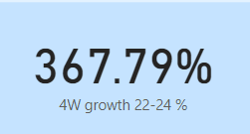
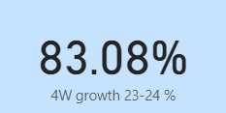
10. Estimate the revenue growth rate of 4-wheeler and 2-wheelers EVs in India for 2022 vs 2024 and 2023 vs 2024, assuming an average unit price
Growth rate in 2-Wheeler category:
Growth rate in 4-Wheeler category:

Slide 13
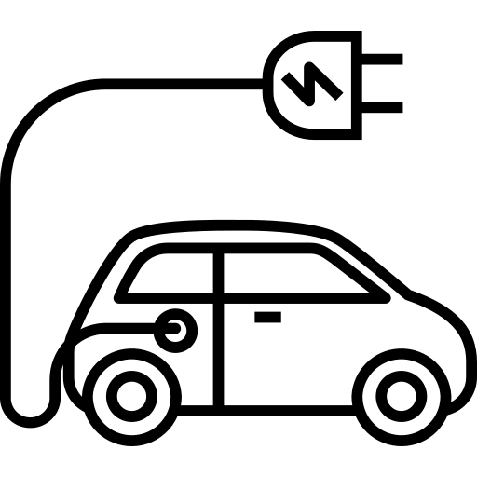
1. What are the primary reasons for customers choosing 4-wheeler EVs in 2023 and 2024 (cost savings, environmental concerns, government incentives)?
Cost and Maintenance savings: Although 4-wheeler EVs often have a higher initial purchase price, the savings on fuel and maintenance over the vehicle's lifetime can make them more cost-effective in the long run as electricity is cheaper than gasoline or diesel.. EVs generally have fewer moving parts compared to internal combustion engine (ICE) vehicles. This results in lower maintenance costs as there are fewer components that wear out or require regular servicing.
Reduced Emissions and Sustainable Energy: 4-wheeler EVs produce zero tailpipe emissions, which helps to reduce air pollution and greenhouse gas emissions, contributing to a cleaner environment.
Many consumers are motivated by the ability to use renewable energy sources, such as solar or wind power, to charge their EVs, further reducing their overall environmental impact.
Government Incentives and Additional Benefits: Governments often provide various financial incentives for purchasing EVs, including tax credits, rebates, and grants. These incentives can significantly reduce the upfront cost of 4-wheeler EVs. In some regions, EV owners may benefit from other perks such as access to high-occupancy vehicle (HOV) lanes, reduced registration fees, and exemptions from certain road tolls.

Slide 14

2. How do government incentives and subsidies impact the adoption rates of 2-wheelers and 4-wheelers? Which states in India provided most subsidies?
Reduction in Purchase Costs: Subsidies and incentives directly reduce the purchase price of electric vehicles (EVs), making them more affordable for consumers. This is particularly crucial for higher-cost vehicles like 4-wheelers
Financial Motivation: Consumers are more likely to adopt EVs when they perceive significant financial benefits from subsidies, which can offset the initial cost of the vehicle.
States in India Providing Most Subsidies:
Delhi, Maharashtra, Karnataka, Tamil Nadu, Telangana offers incentives for both types of EVs play a critical role in increasing the adoption rates of both 2-wheelers and 4-wheelers by making them more financially accessible and reducing the perceived risk of switching to new technology
Market Expansion: Financial incentives can stimulate manufacturers to produce a wider range of EV models, both in terms of variety and affordability, which helps meet diverse consumer needs. Increased adoption driven by incentives often leads to greater investment in EV infrastructure, such as charging stations, further supporting the growth of the EV market.

Slide 15
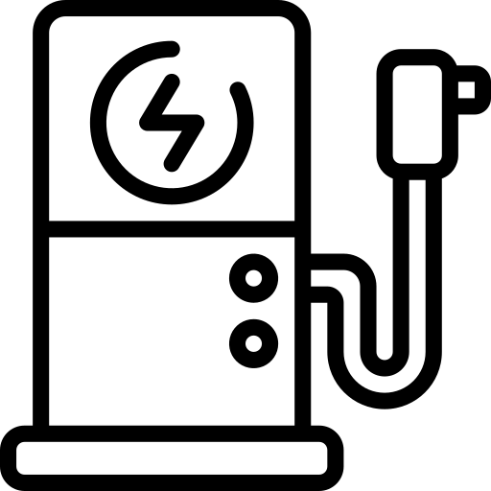
3. How does the availability of charging stations infrastructure correlate with the EV sales and penetration rates in the top 5 states?
The availability and expansion of charging infrastructure have a strong positive correlation with EV sales and penetration rates. In the top 5 states in India—improvements in charging networks directly contribute to higher EV adoption. As these states continue to invest in and expand their charging infrastructure, they are likely to see further increases in EV sales and market penetration. Charging infrastructure reduces range anxiety, improves the convenience of owning an EV, and supports the overall growth of the electric vehicle market.
Delhi, Maharashtra, Karnataka, Tamil Nadu. Telangana states with better-developed charging infrastructure generally see higher EV adoption rates. The availability of charging stations is crucial in reducing range anxiety and making EV ownership more practical
Urban Focus: Major urban centers tend to have more developed charging infrastructure compared to rural areas, which aligns with higher EV adoption rates in these cities.
The growing availability of charging infrastructure is expected to support higher EV penetration rates as both the market and the infrastructure continue to develop.

Slide 16
4. Which state of India is ideal to start the manufacturing unit? (Based on subsidies provided, ease of doing business, stability in governance etc.?
Gujarat offers significant subsidies and incentives for EV manufacturing under its EV Policy, including financial support for setting up manufacturing units and research & development (R&D) initiative.
Gujarat is consistently ranked among the top states in India for ease of doing business. The state has a streamlined regulatory process, efficient single-window clearances, and robust infrastructure
Maharashtra ranks high in ease of doing business due to its established industrial ecosystem, efficient regulatory processes, and supportive business environment.
Maharashtra’s EV policy includes various incentives for manufacturers, such as subsidies on capital investment and support for infrastructure development
Karnataka, particularly Bengaluru, is renowned for its business-friendly environment, efficient processes, and supportive ecosystem for technology and manufacturing.
Karnataka has a stable political environment with a focus on promoting industrial growth and innovation

Slide 17
Top 3 recommendations for AtliQ Motors
Product Strategy
Diversify Product Line: Expand your product portfolio to include a range of EVs that cater to different customer segments— from affordable 2-wheelers to premium 4-wheelers and commercial EVs. Tailor products to meet local needs and preferences.
Enhance Features: Focus on improving key features such as battery life, range, charging speed, and advanced technology. Incorporate cutting-edge technology like AI for autonomous driving, smart connectivity, and advanced safety features.
Quality and Reliability: Ensure high-quality manufacturing standards and reliability. Invest in quality control processes to build a reputation for durable and dependable EVs
Marketing and Brand Positioning
Strong Brand Identity: Build a strong brand presence through consistent messaging that highlights your unique selling points, such as innovation, sustainability, or affordability.
Targeted Marketing Campaigns: Implement targeted marketing campaigns across various channels, including digital media, traditional advertising, and experiential marketing. Tailor campaigns to specific customer demographics and regions.
Customer Testimonials and Influencer Partnerships: Leverage customer testimonials and partner with influencers or brand ambassadors who resonate with your target audience to build trust and credibility
Expansion of Distribution and Sales Channels
Increase Dealership Network: Expand your dealership and service network to cover more geographic areas, especially in high-potential markets. Ensure that your dealers are well-trained and knowledgeable about EVs.
Develop Online Sales Platforms: Strengthen your online presence with an easy-to-navigate website and e-commerce platform. Offer online booking and virtual showrooms to attract tech-savvy customers.
Retail Partnerships: Explore partnerships with retail chains or showrooms to showcase your EVs and make them more accessible to potential buyers
Charging Infrastructure
Invest in Charging Solutions: Either directly invest in or partner with companies to develop charging infrastructure. Consider setting up charging stations in high-traffic areas and major cities.
Home Charging Solutions: Offer incentives or discounts for home charging installations. Partner with charging equipment manufacturers to provide bundled offers.

Slide 18
Thank you
Megha S

